Slide 1
Insurance Business Performance Analysis
Group 3
Aniket Sudhakar Wadekar
ARAVIND.R
Aswin M M
Chetan Vinod Dashpute
Yash Rahul Gaikwad

Slide 2
Insurance Analytics is a project that focuses on leveraging data to gain data-driven insights and make informed decisions in the insurance industry
Data visualization plays a crucial role in insurance analytics as it allows for the effective communication of complex information and trends

Slide 3
Tools Used
Excel
Power BI
Tableau
SQL
3

Slide 4
KPI List used for the Analysis:
No of Invoice by Account Executive
Yearly Meeting Count
Cross Sell-Target, Achieved, New
New-Target, Achieved, New
Renewal-Target, Achieved, New
Stage Funnel by Revenue
No of meeting By Account Executive
Top Open Opportunity
4

Slide 5
No of Meeting
Year | Count of Meeting
2019 | 3
2020 | 31
Grand Total | 34
5

Slide 6
No of Invoices by Account Executive
6

Slide 7
This dashboard is to discuss the performance of business within Ahmedabad branch by considering Cross sell, New and Renewal Numbers
Cross-selling refers to the practice of selling additional insurance policies to an existing customer
Renewal refers to the process of extending an existing insurance policy
New business refers to the process of selling insurance policies to new customers.
7

Slide 8
Achievement
Cross Sell
1.3 Cr
New
35 Lacs
Renewal
1.85 Cr
8

Slide 9
Percentage of Achievement for Placed & Invoiced
Cross Sell
Cross Sell
65%
14%
New
Placed
Invoiced
New
18%
3%
Renewal
Renewal
150%
67%
9

Slide 10
Opportunity Overview
Total
49
Open
44
Top 4 by Revenue
500K
400K
400K
350K
Fire
DB Mega Policy
EL Group Mediclaim
CVP GMC
10

Slide 11
Stage Funnel by Revenue
Quality
5920K
Negotiate
899K
Propose
Solution
60K
11

Slide 12
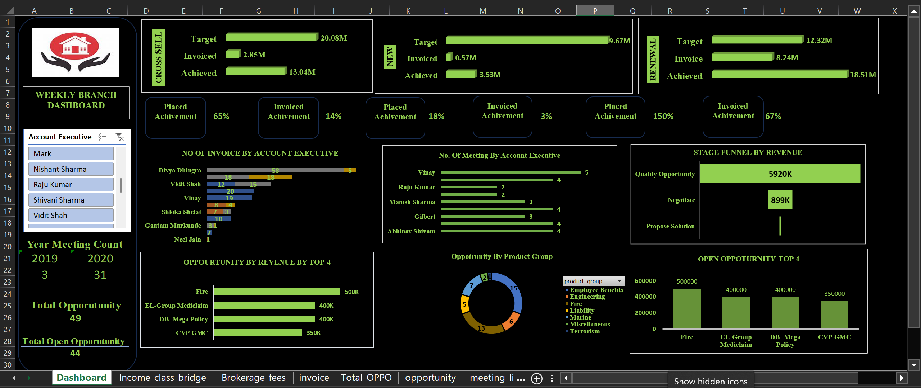
Excel Dashboard
12

Slide 13
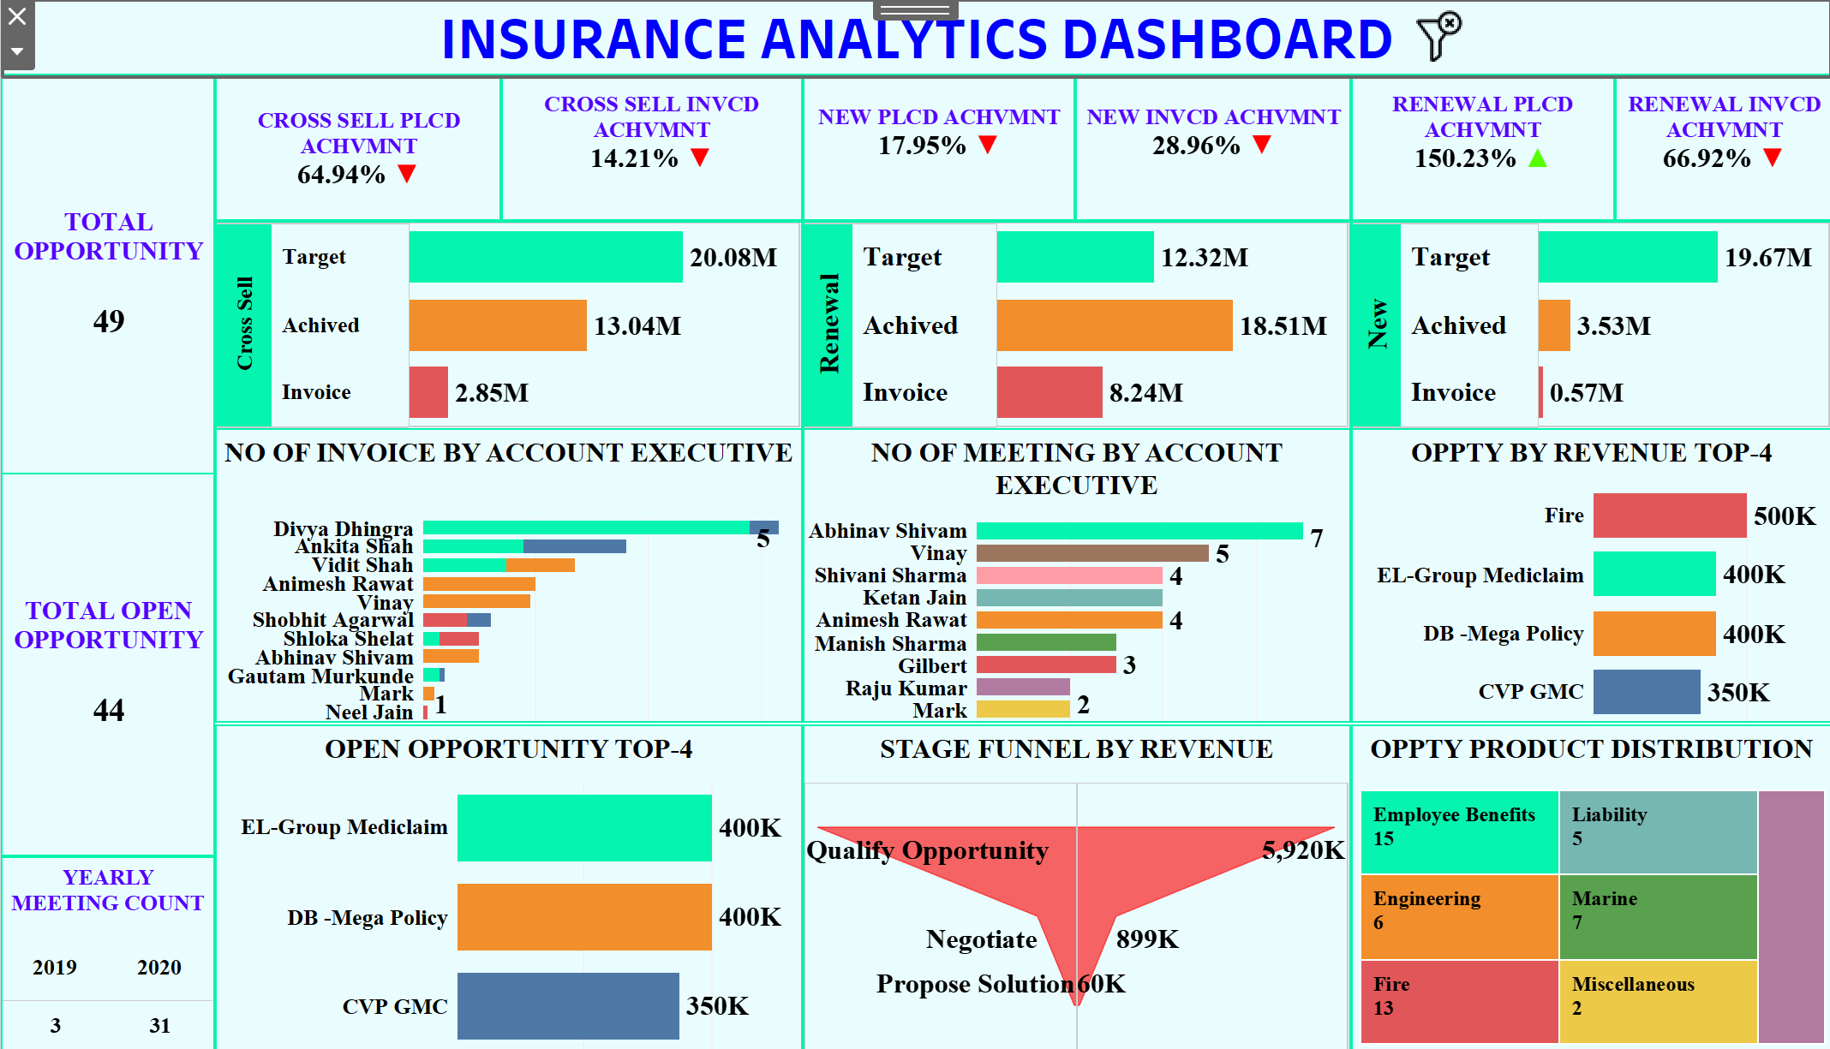
Tableau Dashboard
13

Slide 14
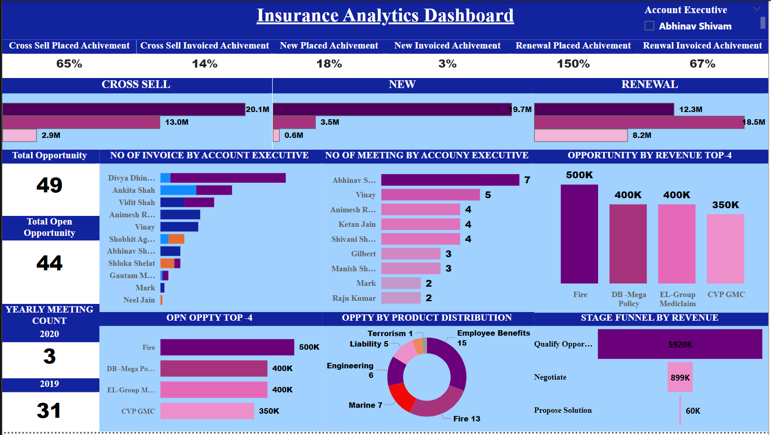
Power BI Dashboard
14

Slide 15
Insights
New policies
Steady growth with the decent profit margin. Need to focus on increasing the growth rate.
Cross sell Policies
High profitability and significant growth. continue leveraging cross-selling opportunities
Renewal polices
Exceptional performance in renewals with very high profitability and growth. Maintain strong focus
CAC
Need to check Customer Acquisition Cost and incentivize new business
15

Slide 16
Thanks For Wathcing

